Slide 1
Evolution of Scientific & Medical Publications:
Navigating Trends, Opportunities & Challenges
Dikran Toroser, PhD
University California San Diego, USA

Slide 2
Agenda
Introduction
RAPID rate of change in PUBLICATIONS
KNOWLEDGE and WISDOM management
VOLUME and DATA overload
SIMPLIFICATION efforts
DEMOCRATIZATION of information
Extenders (PLS, podcasts and other)
GUIDELINES
KEEPING UP with the RAPID change
Questions/Comments

Slide 3
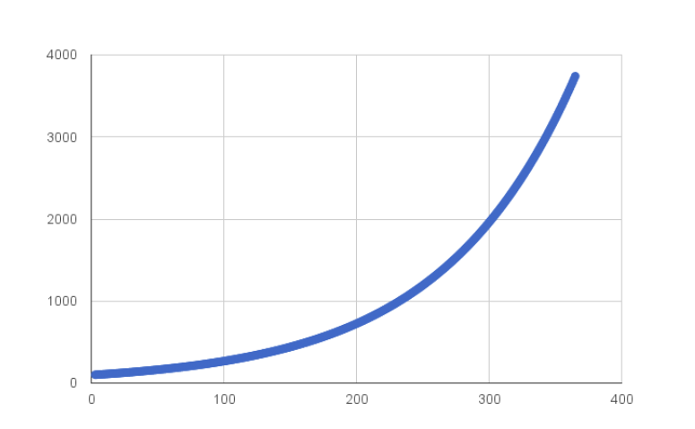
Surge in Medical Publications
Exponential Growth in Medical publications.
Technological & Collaborative Advancements
Open Access & Preprint Servers: Democratized access to research and faster dissemination of information.
Data Sharing & Funding
Challenges and Opportunities facing Medical Publishing. Peter Densen
Ali Dardas et al (2023) 2 decades of research productivity in the Middle Eastern and Arab countries, MDPI. https://www.mdpi.com/2304-6775/11/4/48
Notes:
Volume of publications contributed from Asia has been growing exponentially.
Exponential Growth in Asia:
China: China has seen an exponential increase in scientific publications over the past two decades. From contributing a relatively small number of papers in the early 2000s, China has become one of the top contributors to global scientific literature. …China's share of global scientific publications increased from around 5% in 2000 to over 20% by 2020.
Other Asian Countries: Countries like Japan, South Korea, and India have also significantly increased their output.
Overall: Asia, as a region, now contributes a substantial portion of global scientific publications, with several countries consistently improving their research output and quality.
Comparison with the West:
United States and Europe: The US and European countries have traditionally dominated global scientific publications. They continue to lead in terms of quality and high-impact publications, but the gap is narrowing as Asian countries increase their output.
Growth Rates: While the US and Europe have seen steady growth in publications, the growth rate in Asia has been more pronounced. The rapid development of research infrastructure, increased funding, and government policies promoting science and technology have all contributed to this exponential growth in Asia.
High-Impact Journals:
Western Dominance: High-impact journals are still predominantly based in the West, such as Nature, Science, and The Lancet. However, the number of high-impact journals originating from Asia is on the rise, and more Asian researchers are publishing in these Western journals.
Increasing Influence: Asian journals are gaining international recognition, and the quality of research from Asia is increasingly matching that of Western counterparts, reflecting the region's growing influence in global scientific discourse.
This information underscores the exponential growth of publications from Asia and highlights the shifting dynamics in global scientific research and publication volumes.

Slide 4
Increase in Knowledge = Opportunities
https://blog.re-work.co/can-we-trust-ai/
Generative AI And LLMs are changing our work; Profoundly
Insights and opportunity…but also misinformation
Look forward to: Job creation and job transformation
AI leads to increased productivity
Potential to fill skill-gap between low- and high-skilled tasks
CAUTION: using AI without proper HUMAN OVERSIGHT could be problematic
ISMPP position statement and call to action on AI (2024) 40 (1), 9-10 https://www.tandfonline.com/doi/epdf/10.1080/03007995.2023.2273139?needAccess=true
The AI Index 2024 Annual Report. AI Index Steering Committee, Institute for Human-Centered AI, Stanford University, Stanford, CA, April 2024.https://aiindex.stanford.edu/wp-content/uploads/2024/05/HAI_AI-Index-Report-2024.pdf

Slide 5
Data Overload Problem
Data abundance:
thousands of articles per day
Information overload: HCPs struggling to keep up
Quality concerns: …difficult to determine reliability
SIMPLIFICATION needed: Data ACTIONABLE insights
Docs Struggle to keep up with the Flood of New Medical Knowledge. 0.2 years [73 days !] https://ourthinking.think-gen.com/docs-struggle-to-keep-up-with-the-flood-of-new-medical-knowledge
https://www.medscape.com/viewarticle/989043?form=login&scode=msp&st=fpf_login&socialSite=google&icd=login_success_email_match_fpf

Slide 6
Dawn of the Wisdom worker
Knowledge Worker¹
Freely available knowledge
WISDOM WORKER² is here…knowledge workers (we) will need to evolve
SIMPLIFICATION³ of vast amounts of freely available (ie. commoditized) information
¹Knowledge work performance https://www.cipd.org/globalassets/media/knowledge/knowledge-hub/factsheets/8296-knowledge-workers-scientific-summary.pdf
²EVOLUTION of Knowledge Management Towards WISDOM management. Maria Jakubik (2023) Journal of Information & Knowledge Management, 22 (4) 2350051
³Building a Second Brain. Tiago Forte (2024) A proven method to Organize your digital life

Slide 7
Knowledge Management¹ Wisdom Management
OPPORTUNITIES
Wisdom Simplification Systems: Tools that distill ideas…making wisdom more accessible and ACTIONABLE.
Wisdom Transfer: Methods to effectively share key insights
Wisdom-Driven Optimization: Applying collective wisdom to improve DECISION-MAKING and operational efficiency.
Practical Wisdom Cultivation: Developing wisdom at PERSONAL and ORGANIZATIONAL levels, focusing on real-world application
What is WISDOM MANAGEMENT
Definition: Focusing on applying knowledge with
sound judgement and ethical considerations
Focus: Synthesizing and applying knowledge with discernment, experience, and ethical reasoning
COMPONENTS: Involves reflective practices, ethical considerations, leveraging experience, and intuition
Tom Davenport, Distinguished Professor, Babson College
https://www.linkedin.com/pulse/whatever-happened-knowledge-management-tom-davenport/
https://www.ismpp-newsletter.com/2021/08/18/translations-presentations-of-joint-position-statement-advocating-for-pre-publication-review/
Notes:
What is KM? Knowledge Management Explained
……Recapping its origins.
The Origins of KM
KM sprouted within the management consulting community.
The term apparently was first used in its current context at McKinsey in 1987 for an internal study on their information handling and utilization (McInerney and Koenig, 2011). KM went public, as it were, at a conference in Boston in 1993 organized by Ernst and Young (Prusak 1999). Note that Davenport was at E&Y when he wrote the definition above.
Those consulting organizations quickly disseminated the principles and the techniques of KM to other organizations, to professional associations, and to disciplines. The timing was propitious, as the enthusiasm for intellectual capital (see below) in the 1980s, had primed the pump for the recognition of information and knowledge as essential assets for any organization.

Slide 8
Making Medical Knowledge More Accessible
Inclusion Democratization
SIMPLIFY publications:
e.g, Plain language summaries and other extenders (see GPP 2022)
2. “FREE” Open access:
Medical knowledge more widely available
Challenges
Quality control remains crucial to ensure reliability of information
Ethical Concerns eg AI offers new solutions, as well as ethical questions
Pubs extendors: https://www.medcomms-experts.com/medical-publication-extender-strategy-formats/

Slide 9
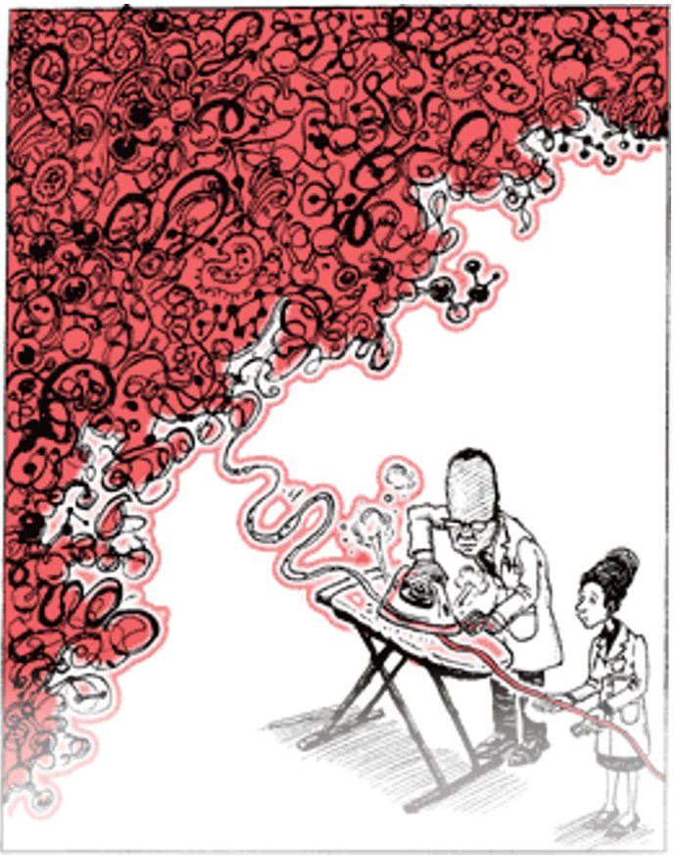
Use Case Scenarios…
PLS-Ps and Other Extenders
Pub extenders: eg, PLS, infographics, video,
democratize knowledge:
Empower readers (the whole “ecosystem of readers”)
Improve awareness + cross-disciplinary collaboration
Enhancing accessibility to complex information
Pharma's adoption these tools is good (but heterogeneous):
Regulatory/legal concerns, resource constraints
Resistance to change, competitive considerations
Call to action: To improve uneven adoption by industry

Slide 10
PATIENTS as Co-authors:
Reshaping Medical Pubs
Trend: Including patients as co-authors on medical publications.
Recognizes patient perspectives…UNIQUE/VALUABLE insights
Encourage this practice
Can lead to more patient-centered/valuable research
Some challenges in defining authorship criteria
Limited by patient availability and expertise
https://globalforum.diaglobal.org/issue/august-2022/involving-patients-as-authors-of-company-sponsored-journal-publications/

Slide 11
Authorship: Patients and DE&I
Inclusivity in medical authorship:
Underrepresentation of women and underrepresented groups (“UREGs”)
Efforts to increase diversity in research teams
Tackling language barriers
Proactively enabling contributions from low/middle-income countries
Recognizing diverse forms of expertise (eg, community knowledge)
PharmaLive, The industry impact of President Biden’s Executive Order: “Most datasets available online used for AI models are based on work published by white male European authors and are not indicative of the wider socio-economic demographics of society. That’s why auditing these AI data sets by including essential human oversight in the early design stages is critical…” https://www.pharmalive.com/the-industry-impact-of-president-bidens-executive-order/

Slide 12
Guidelines and Professional Organizations
Position Statements
eg, JPS, GPP 2022, AI position statement
Common Themes
Ethical Integrity and Transparency
Publication Quality and Timeliness
Authorship Accountability and Inclusivity
Collaborative and Patient-Centric Approach
Adaptation to Evolving Publication Practices
AI Position statement and call to action: https://www.ismpp.org/artificial-intelligence-ai-
GPP 2022 Where are we now? https://lifesciences.enago.com/blogs/gpp-2022-where-are-we-now
ACSE Panel Discussion on GPP 2022: https://youtu.be/EcjJaJpoFf0?si=tafKHDSNq4r56FBs

Slide 13
Call to Action
Discuss innovations in publications - Highlighting necessity and urgency.
Technology, digital transformation, and their potential impact.
Collaboration, integrity, and the application of artificial intelligence are crucial for progress.
Action Items
Engage in discussions about innovations and ideas
Understand the importance of technology and digital transformation.
Collaborate with experts to apply artificial intelligence ethically.
Focus on SIMPLIFYING information in a appropriate way as a driver for accessibility.

Slide 14
Careers in Publications
Rapid GROWTH: Increase in the volume and quality of publications, especially from Asia, reflecting the region's growing investment in healthcare and research. ….Growth=Opportunity.
Tech ADVANCE: Adoption of advanced technologies. EMBRACE PROGRESS/CHANGE and new platforms in the publication space.
Diverse OPPORTUNITIES: Evolving roles in medical writing, editing, and management.
Global COLLABORATION: Increased collaboration between Asian researchers and international peers, leading to more impactful contributions.
Professional DEVELOPMENT: Professional organizations such as ACSE, fostering skills development, networking and advancement in medical publications.

Slide 15
It’s an Exciting Time in Medical Publications!
Ethical Integration of New Technology
Open Access to information and enhanced data sharing
Patient-Centric and Real-World Evidence Research
Interdisciplinary Collaboration
Enhanced Peer Review and Preprint Repositories
Combatting Misinformation and Promoting Ethical Practices
“Buckle-up” for the next 10 years (and exciting opportunities)

Slide 16
Questions/Comments

